Slide 1
UNIT 3
JAVASCRIPT

Slide 2
REFERENCE MATERIAL
Robert W. Sebesta (2015), Programming The World Wide Web, Eighth Edition, Pearson
Chapter 4

Slide 3
INTRODUCTION

Slide 4
HTML,CSS & JavaScript
Your Browser =HTML + CSS + JavaScript
HTML Defines the Structure
CSS defines aesthetic and layout appeal
JavaScript provides interactivity

Slide 5

What is interactive

Slide 6
DOM
Document Object Model
a hierarchical structure that your browser uses to make sense of everything on a webpage
DOM is made up of nodes
Nodes consist of
elements
attributes,
text content,
comments,
document-related stuff,
Every HTML element you want to access has a particular type associated with it, and all of these types extend from the Node base that make up all nodes:

Slide 7
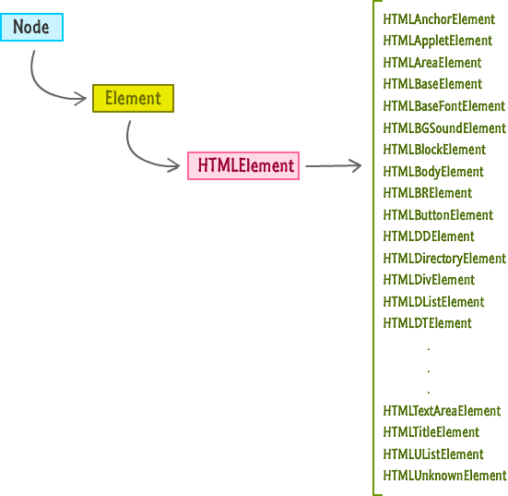

Slide 8
<!DOCTYPE html>
<html>
<head>
<meta content="sea otter, kid, stuff" name="keywords">
<meta content="Sometimes, sea otters are awesome!" name="description">
<title>LOL! Sea Otter! Little Kid!</title>
<link href="foo.css" rel="stylesheet"/>
</head>
<body>
<div id="container">
<img src="seaOtter.png"/>
<h1>The Sea Otter Did to This Little Kid Will Make You LOL!</h1>
<p class="bodyText">
Nulla tristique, justo eget semper viverra, massa arcu hendrerit at semper sed, feugiat a nisi.
<p>
<div class="submitButton">
next
</div>
</div>
<script src="stuff.js"></script>
</body>
</html>

Slide 9
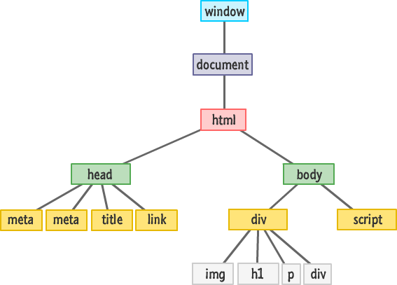

Slide 10
DEMO

Slide 11
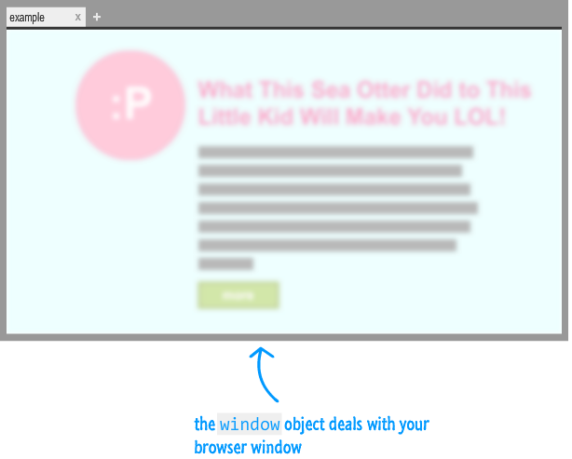
The Window Object
A global object that contains many properties and methods that help to work with a browser

Slide 12
The Document Object
The document object is the gateway to all the HTML elements on a webpage
Document object is not a read-only version of the HTML document.
It is used to read as well as manipulate HTML documents at will.

Slide 13
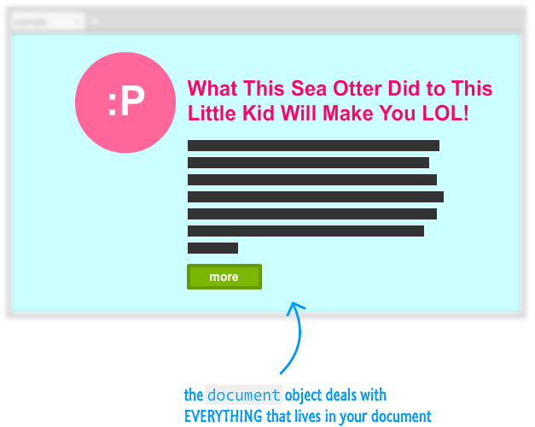
The Document Object

Slide 14
JavaScript & DOM
Changes made to the DOM via JavaScript is reflected in what gets shown in the browser
Using JavaScript you can
dynamically add elements
remove them
move them around
modify attributes on them
set CSS styles
A fully functioning webpage can be made using only JavaScript

Slide 15
Querying the DOM
document.getElementById
document/node.getElementsByTagName
document.getElementsByName
document/node.getElementsByClassName
querySelector
querySelectorAll

Slide 16
document.getElementById
<body>
<div id="info">Info</div>
<script>
var div = document.getElementById('info')
alert( div.innerHTML )
</script>
</body>
Return a single element (node) with certain id.
If no element is found, null is returned.

Slide 17
querySelector
var element = document.querySelector("< CSS selector >");
querySelector function takes a CSS selector as argument.
Returns the first element it finds that matches the selector
var element = document.querySelector("#main");
var element = document.querySelector(".pictureContainer");

Slide 18
DEMO
<div id="main">
<div class="pictureContainer">
<img class="theimage" src="smiley.png" height="300" width="150"/>
</div>
<div class="pictureContainer">
<img class="theimage" src="tongue.png" height="300" width="150"/>
</div>
<div class="pictureContainer">
<img class="theimage" src="meh.png" height="300" width="150"/>
</div>
<div class="pictureContainer">
<img class="theimage" src="sad.png" height="300" width="150"/>
</div>
</div>

Slide 19
querySelectorAll
var elements = document.querySelectorAll("< CSS selector >");
Returns an array of elements!
var images = document.querySelectorAll(".theimage");
for (var i = 0; i < images.length; i++) {
var image = images[i];
alert(image.getAttribute(src));
}

Slide 20
querySelectorAll
var images = document.querySelectorAll("img");
var images = document.querySelectorAll("img[src='meh.png']");

Slide 21
Caution!!
Not all pseudo-class selectors are allowed. A selector made up of :visited or :link is ignored and no elements are found.
How crazy you can go with the selectors you provide depends on the browser's CSS support. Internet Explorer 8 supports querySelectorand querySelectorAll. It doesn't support CSS3. Given that situation, using anything more recent than the selectors defined in CSS 2 will not work when used with querySelector and querySelectorAll on IE8.
The selector you specify only applies to the descendants of the starting element you are beginning your search from. The starting element itself is not included.

Slide 22
Modifying the DOM
Every HTML tag, style rule, and other things that go into your page has a corresponding representation in the DOM.
HTML elements are so versatile when viewed via the DOM is because they share a lot of similarities with JavaScript Objects.

Slide 23
A simple example!!!
<html>
<head>
<title>Hello...</title>
<style>
.highlight {
font-family: "Arial";
padding: 30px;}
.summer {
font-size: 64px;
color: #0099FF; }
</style>
</head>
<body>
<h1 id="theTitle" class="highlight summer">
What'shappening?</h1>
<script>
</script>
</body>

Slide 24
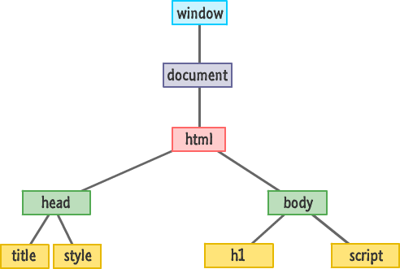

Slide 25
Modify the text
<body>
<h1 id="theTitle" class="highlight summer">What's happening?</h1>
<script>
var title = document.querySelector("#theTitle");
title.textContent = “Nothing going on";
</script>
</body>

Slide 26
getAttribute
<body>
<h1 id="theTitle" class="highlight summer">What's happening?</h1>
<script>
var title = document.querySelector("h1");
alert(title.getAttribute("id"));
</script>
</body>
To retrieve the value of an attribute on the element
returns the value associated with that attribute
if an attribute name doesn't exist, it returns null

Slide 27
setAttribute
<body>
<h1 id="theTitle" class="highlight summer">What's happening?</h1>
<script>
var a=document.getElementById( “theTitle”)
a.setAttibute(“class” ,”foo”)
</script>
</body>
To set the value of an attribute of the element

Slide 28
className
<body>
<h1 id="theTitle" class="highlight summer">What's happening?</h1>
<script>
var title = document.querySelector("h1");
alert(title.id);
title.className = "bar foo";
</script>
</body>
To retrieve the class of any element

Slide 29
Setting Styles
var myElement = document.querySelector("#superman");
myElement.style.backgroundColor ="#D93600";
Every HTML element that you access via JavaScript has a style object.
This object allows you to specify a CSS property and set its value

Slide 30
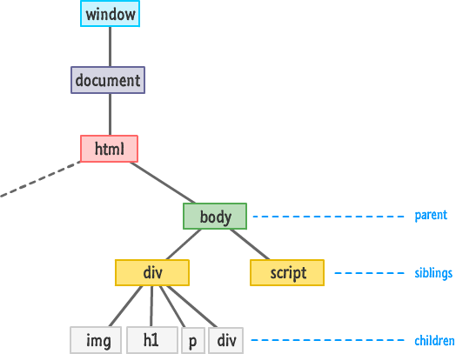
Traversing the DOM

Slide 31
Meet The Family!!
firstChild
lastChild
parentNode
children
previousSibling
nextSibling

Slide 32
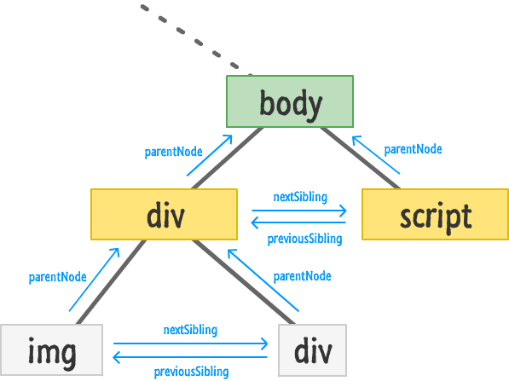

Slide 33
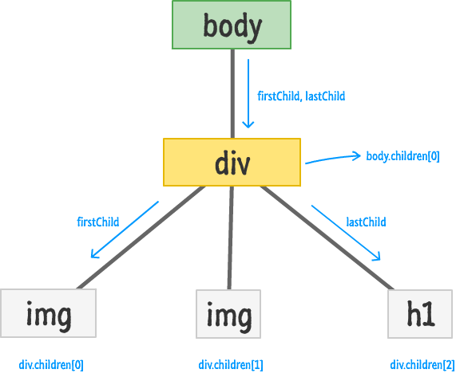

Slide 34
Checking If A Child Exists
var bodyElement = document.body;
if (bodyElement.firstChild) {
// do something interesting
}
If statement will return null if there are no children
Can also be used with
bodyElement.lastChild
bodyElement.children.length

Slide 35
Accessing All the Child Elements
var bodyElement = document.body;
for (var i = 0; i < bodyElement.children.length; i++) {
var childElement = bodyElement.children[i];
alert(childElement.tagName);
}

Slide 36
Creating Elements
document.createElement("p");
To create a new element on a page
Call the createElement method through the document object
Pass the tag name of the object to be created

Slide 37
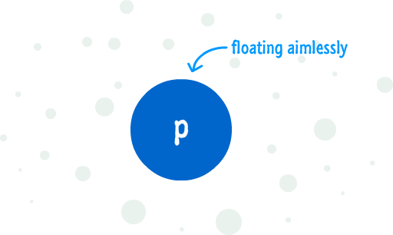
To add it to the DOM
Find an element that will act as the parent
Use appendChild and add the newly created element to the parent element

Slide 38
<body>
<h1 id="theTitle" class="highlight summer">What's happening?</h1>
<script>
var newElement = document.createElement("p");
newElement.textContent = "I exist entirely in your imagination.";
document.body.appendChild(newElement);
</script>
</body>

Slide 39
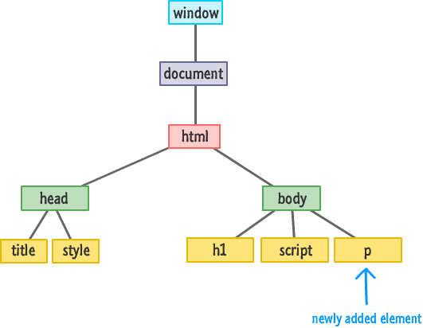
The DOM after appending

Slide 40
insertBefore
<body>
<h1 id="theTitle" class="highlight summer">What's happening?</h1>
<script>
var newElement = document.createElement("p");
newElement.textContent = "I exist entirely in your imagination.";
var scriptElement = document.querySelector("script");
document.body.insertBefore(newElement, scriptElement);
</script>
</body>
The insertBefore function takes two arguments.
The first argument is the element you want to insert.
The second argument is a reference to the sibling you want to precede.

Slide 41
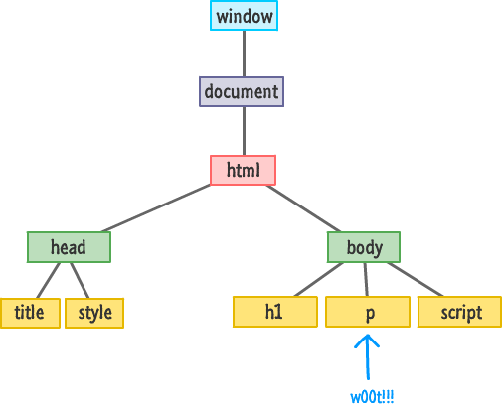

Slide 42
Removing Elements
<body>
<h1 id="theTitle" class="highlight summer">What's happening?</h1>
<script>
var newElement = document.createElement("p");
newElement.textContent = "I exist entirely in your imagination.";
document.body.appendChild(newElement);
document.body.removeChild(newElement);
</script>
</body>

Slide 43
JavaScript Events

Slide 44
What are Events?

Slide 45
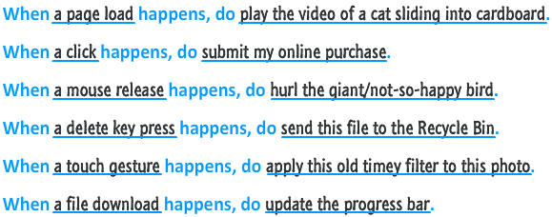

Slide 46
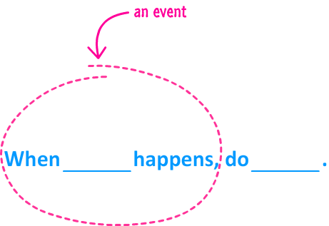
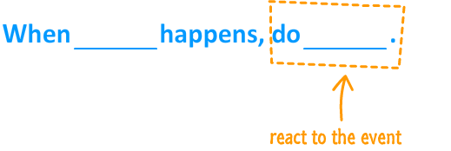

Slide 47
Events
An event is a signal.
It communicates that something has just happened. This could be a
mouse click
a key press on the keyboard
a window getting resized.
a document simply getting loaded
Events define the thing that happens. They fire the signal.
The second part of the model is defined by the reaction to the event

Slide 48
Javascript Events
To work with events, there are two things you need to do:
Listen for events
inline model
traditional model
W3C model
React to events

Slide 49
Inline Model
<body>
<input type="button" id="askme" value="Ask me" onclick="ask()"/>
<script>
function ask(){
var a =window.prompt("Please ask a question")
alert("I am sorry I don't know the answer")
}
</script>
</body>

Slide 50
Traditional Model
<body>
<input type="button" id="askme" value="Ask me"/>
<script>
var a=document.getElementById("askme");
a.onclick=ask;
function ask(){
var a =window.prompt("Please ask a question")
alert("I am sorry I don't know the answer")
</script>
</body>

Slide 51
W3C Model
<body>
<input type="button" id="askme" value="Ask me" />
<script>
var a=document.getElementById("askme");
a.addEventListener("click",ask,false)
function ask(){
var a =window.prompt("Please ask a question")
alert("I am sorry I don't know the answer")
}
</script>
</body>

Slide 52
Common Events
Event | Event is fired...
click | ...when you press down and release the primary mouse button / trackpad /
mousemove | ...whenever your mouse cursor moves
mouseover | ...when you move the mouse cursor over an element. This is the event you would use for detecting a hover!
mouseout | ...when your mouse cursor moves outside the boundaries of an element.
dblclick | ...when you quickly click twice.
DOMContentLoaded | ...when your document's DOM has fully loaded. You can learn more about this event in the following tutorial.
load | ...when your entire document (DOM, external stuff like images, scripts, etc.) have fully loaded.
keydown | ...when you press down on a key on your keyboard
keyup | ...when you release a key press on your keyboard
scroll | ...when an element is scrolled around
wheel & DOMMouseScroll | ...everytime you use your mousewheel to scroll up or down

Slide 53
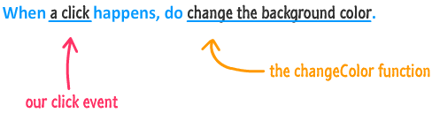

Slide 54
Event
Event Handler
Functions that handle events
Registering Events
Assign an event handler to a DOM node

Slide 55
onload Event
Whenever and element finishes loading
Generally used with the body element
Demo: A program to calculated how many seconds elapsed since document loaded

Slide 56
<html>
<head>
<title>onload Event</title>
<script type = "text/javascript">
var seconds = 0;
function startTimer()
{ window.setInterval( "updateTime()", 1000 ); }
function updateTime()
{
++seconds;
document.getElementById( "soFar" ).innerHTML = seconds;
}
</script>
</head>
<body onload = "startTimer()">
<p>Seconds you have spent viewing this page so far:
<strong id = "soFar">0</strong></p>
</body>
</html>

Slide 57
<img src=“tulips.png" onload="loadImage()" width="100"height="132"> <script> function loadImage() { alert("Image is loaded"); } </script>

Slide 58
Onmousemove event Object & this
onmousemove event fires whenever the user moves the mouse
event object stores information about the event that called the event-handling function
ctrlKey property contains a boolean which reflects whether the Ctrl key was pressed during the event
shiftKey property reflects whether the Shift key was pressed during the event
In an event-handling function, this refers to the DOM object on which the event occurred
this keyword enables one event handler to apply a change to one of many DOM elements, depending on which one received the event

Slide 59
event Object Properties

Slide 60
Rollovers with onmouseover and onmouseout
When the mouse cursor enters an element, an onmouseover event occurs for that element
When the mouse cursor leaves the element, an onmouseout event occurs for that element
The event object stores the node on which the action occurred
In Internet Explorer, this node is stored in the event object’s srcElement property
In Firefox, it is stored in the event object’s target property

Slide 61
Form Processing with onfocus and onblur
onfocus event fires when an element gains focus
i.e., when the user clicks a form field or uses the Tab key to move between form elements
onblur fires when an element loses focus
i.e., when another control gains the focus

Slide 62
More Form Processing with onsubmit and onreset
onsubmit and onreset events fire when a form is submitted or reset, respectively
Anonymous function
A function that is defined with no name
Created in nearly the same way as any other function, but with no identifier after the keyword function
Useful when creating a function for the sole purpose of assigning it to an event handler
confirm method asks the users a question, presenting them with an OK button and a Cancel button
If the user clicks OK, confirm returns true; otherwise, confirm returns false
By returning either true or false, event handlers dictate whether the default action for the event is taken
If an event handler returns true or does not return a value, the default action is taken once the event handler finishes executing

Slide 63
Event Bubbling
events ripple and affect a bunch elements that lie in their path

Slide 64
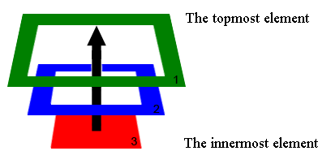
Event Bubbling
The bubbling guarantees that click on Div 3 will trigger onclick first on the innermost element 3
(also caled the target), then on the element 2, and the last will be element 1.

Slide 65
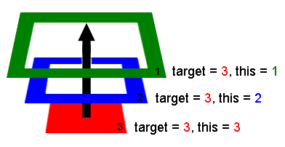
The deepest element which triggered the event is called the target or, the originating element.
When handlers trigger on parents:
event.target/srcElement - remains the same originating element.
this - is the current element, the one event has bubbled to, the one which runs the handler.

Slide 66
<body id="theBody" class="item">
<div id="one_a" class="item">
<div id="two" class="item">
<div id="three_a" class="item">
<button id="buttonOne" class="item">one</button>
</div>
<div id="three_b" class="item">
<button id="buttonTwo" class="item">two</button>
<button id="buttonThree" class="item">three</button>
</div>
</div>
</div>
<div id="one_b" class="item">
</div> </body>

Slide 67
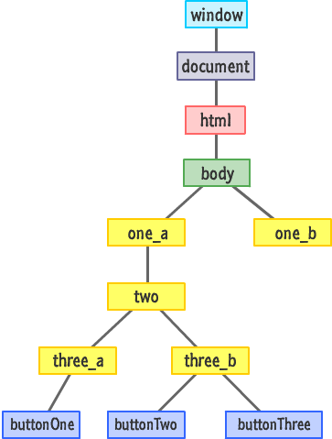

Slide 68
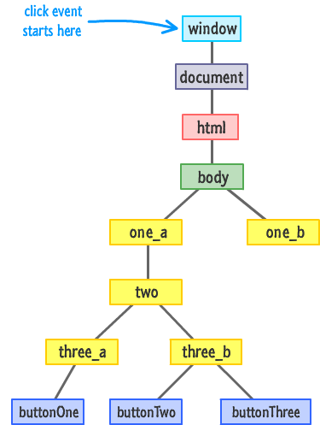

Slide 69
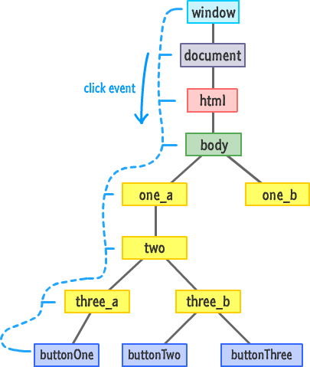

Slide 70
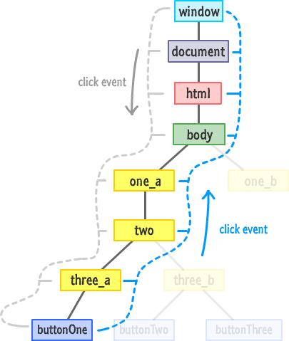

Slide 71
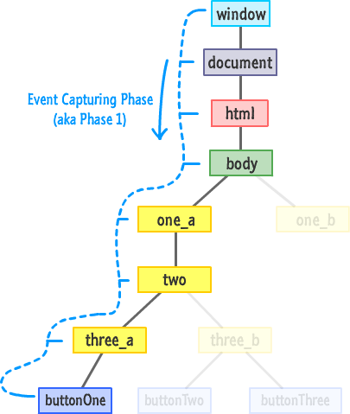

Slide 72
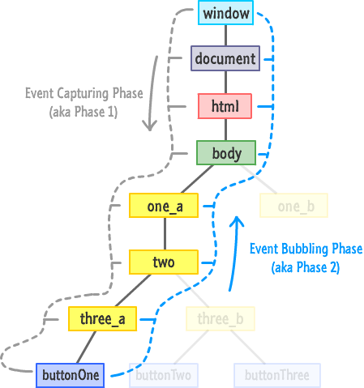

Slide 73
